Slide 1


Asset Management System
IGATE is now a part of Capgemini

Slide 2
TEAM MEMBERS
D. Jahnavi
G. Kavya Sri
M. Pallavi
Simran Malhotra

Slide 3
CONTENTS
OVERVIEW
ACTORS
TESTCASE
REQUIREMENT ITEMIZATION
USECASE
DEFECTS
APPLICATION LINK
TEST CASE ADEQUACY
TEST CASE EFFECTIVENESS
PROJECT STATISTICS
TRACEABALITY MATRIX

Slide 4
OVERVIEW OF THE PROJECT
The website is designed to accomplish the Asset Management System for an Organization. This is an Intranet based application that can be accessed throughout the organization. This system is used to raise a request for an asset and assign a asset to/from an employee. This helps serving our needs by allocating assets. This website systematically processes asset requests, operating, maintaining, upgrading, and disposing of assets effectively.

Slide 5
ACTORS
Administrator.
Manager/User

Slide 6
TEST CASES
A test case is a set of conditions or variables under which a tester will determine whether a system under test satisfies requirements or works correctly.
The process of developing test cases can also help find problems in the requirements or design of an application.

Slide 7
Link : AMS TEST cASE
TEST CASES
LOGIN
Admin
Modifying an asset
Adding an asset
Deleting an asset
Approve request
View request
Delete request
Manager/User
Login
Raise request
View Status

Slide 8
REQUIREMENT ITEMIZATION
Requirements validation is an iterative process which takes place throughout the lifecycle of the project.
During elicitation, analysis and specification you should constantly be questioning and clarifying the data given to you in order to check its validity.
This will ensure that the SRS that you produce is complete, consistent and ready for the formal validation process.
LINK: AMS RVFD

Slide 9
Requirements Validation And Functional Decomposition
Termination
End process
File Handling
Storage of information
Invocation
Start process
Implicit
Efficiency
RVFD
System
Minimum specifications
Explicit
User specified
Query
improvements
Error Handling
consistency
Security
For confidentiality

Slide 10
USE CASES
A use case is a methodology used in system analysis to identify, clarify, and organize system requirements.
The use case is made up of a set of possible sequences of interactions between systems and users in a particular environment and related to a particular goal.
A use case can be thought of as a collection of possible scenarios related to a particular goal, indeed, the use case and goal are sometimes considered to be synonymous.
LINK:AMS_USECASE

Slide 11
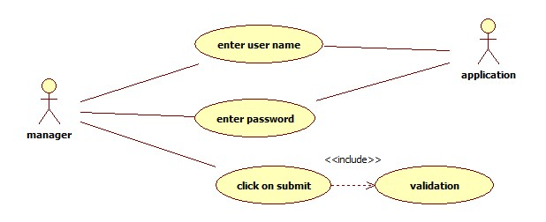
USE CASES
1. For Successful Login

Slide 12
USE CASE DIAGRAM
2. For Successful Raise A Request

Slide 13
USE CASE DIAGRAM
3. For Viewing The Asset Status

Slide 14
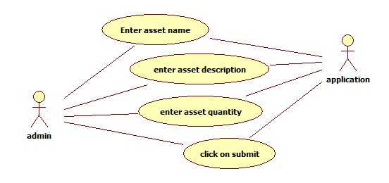
USE CASE DIAGRAM
4. For Successful Addition Of Asset

Slide 15
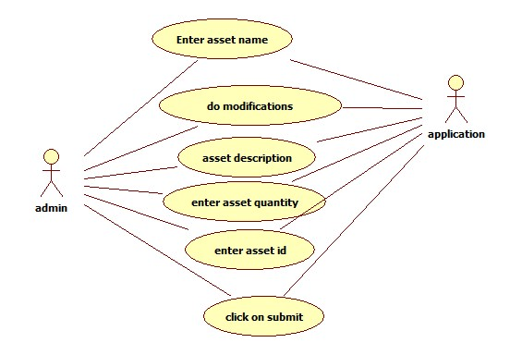
USE CASE DIAGRAM
5. For Successful Modification Of Asset

Slide 16
USE CASE DIAGRAM
6. For Successful Deletion Of Asset

Slide 17
DFDR
A defect is an error or a bug, in the application that causes it to produce an incorrect or unexpected results.
A programmer while designing and building the software can make mistake or error.
These mistakes or errors mean that there are flaws in the software, these are called defects and the report written for logging these defects is called a defect report.
LINK: AMS DEFECT

Slide 18
DEFECTS FOUND
Manager
The system does not display appropriate error message on entering invalid username and invalid password
Some of the links present in all the pages is not navigating the user to proper web page
There are some common spelling mistakes in all the pages
The manager is found to raise a request even with entering invalid values in the Asset details fields
The manager is found to raise a request even with entering null values in the Asset details fields
The user is able to view status of raised request even with entering invalid Emp No

Slide 19
DEFECTS FOUND
The system does not display appropriate error message on leaving both the username and password fields as blank
The system does not display appropriate error message on entering invalid username and invalid password
Some of the links present in all the pages is not navigating the user to proper web page
There are some common spelling mistakes in all the pages
The system does not display appropriate error message on leaving asset details fields as blank
The system does not display appropriate error message on entering invalid values in asset details fields
Admin

Slide 20
Defect Summary
The spelling of Login page in Home page wrongly diplayed as Logn page.
The name field in the login page is found to accept special characters and digits.
The password field in the login page is found to accept more than 8 characers.
On clicking about us link in web page, it is not redirecting to another page.
The asset quantity field in the Raise a Request page is found to accept alphabets and special characters.
The asset description field in the Raise a Request page is found to accept alphabets and special characters.
The Asset name field in the add asset web page is found to accept special characters and digits.

Slide 21
When asset description is entered in the add asset web page,there is no word limit set.
The asset quantity field in the add asset page is found to accept alphabets and special characters.
The asset id field in the view status screen page is found to accept more than 4 characters.

Slide 22

Application link
http://ndafile:8081/AssetManagementSystem_Spring/index.html

Slide 23
Test Case Adequacy
This defines the number of actual test cases created vs estimated test cases at the end of test case preparation phase. It is calculated as
Test Case Adequacy = No. of actual Test cases*100/No. of estimated Test cases estimated
=(159*100)/200
=79.5

Slide 24
Test Case Effectiveness
This metrics defines the effectiveness of the test cases which is measured in terms of the number of defects found in testing with using the test cases.
Test Case Effectiveness = No. of defects detected using test cases*100)/total no of defects detected in testing
=(53*100)/70
=75.71
LINK:TEST_CASE

Slide 25
Project Statistics
Number of Test Cases = 159
Number of Test Cases Passed = 106
Number of Test Cases Failed = 53
Number of Defects Logged = 44
Number of Use Cases = 9

Slide 26
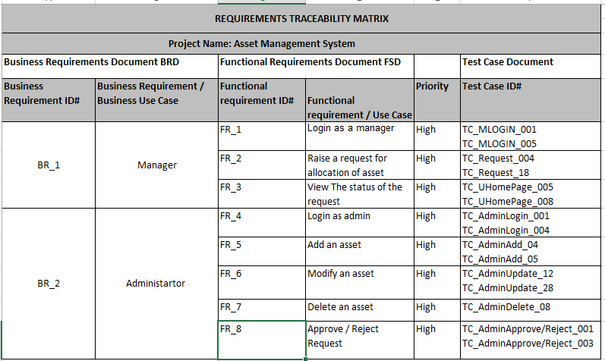
Traceability Matrix

Slide 27
THANK YOU

